Slide 1
SWAMI VIVEKANAND COLLEGE OF ENGINEERING, INDORE
COMPUTER SCIENCE AND ENGINEERING DEPARTMENT
SESSION : JAN – MAY 2018
Real Time Analysis of Soil Fertility
Guided By:
Mr. Ambrish Srivstav
Asst. Prof. Department of CSE
SVCE, Indore
Mr. Archit Shukla
Asst. Prof. Department of CSE
SVCE, Indore
Presented By:
Burhanuddin Saify
(0822CS151025)
Neeraj Vyas
(0822CS151060)

Slide 2
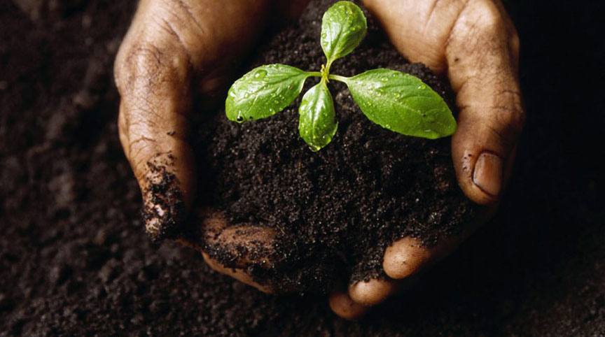
Table of Content
Abstract
Introduction
Literature Review
Objective
Architectural Diagram
ER Diagram
Use Case Diagram
Activity Diagram
Sequence Diagram
Software & Hardware Requirements
Future Work
Conclusion
References

Slide 3
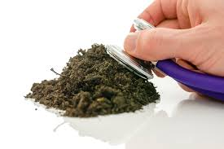
Abstract
With evolution in technology various agricultural practices have shifted from traditional techniques to automated techniques.
One of the most important parameter in farming is soil fertility, i.e. ratio in which various nutrients and parameters essential for crops are present in the soil.[1]
In the proposed system we will determine
the average percentage of basic soil’s N, P and K content,
pH value, [4]
temperature,
humidity,
moisture and
light intensity.

Slide 4
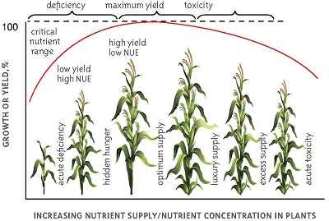
Introduction
For many years soil analysis has been used as an aid for assessing soil fertility and plant nutrient management.
The 3 important steps in managing the nutrient requirement of plants is:
Soil sampling and analysis.
Interpretation of analytical data.
Recommendation for nutrient addition as fertilizer or manure to optimize crop yields. [2]

Slide 5
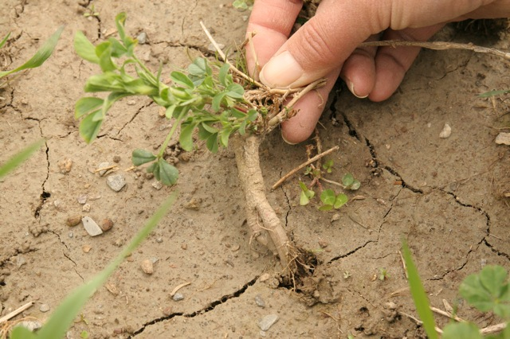

Literature Review
Use-case diagram,
Low fertility of soils is the major constraint to achieving high productivity goals. Soil should have to be rich in nutrients basically N, P and K.
According to the scholarly research,
The term soil health is often preferred to soil quality by farmers, while scientists relate the term "soil health" to the status of various biological properties in the soil (Haberem, 1992; Romig et aI., 1995; Harris et aI. 1996).

Slide 6
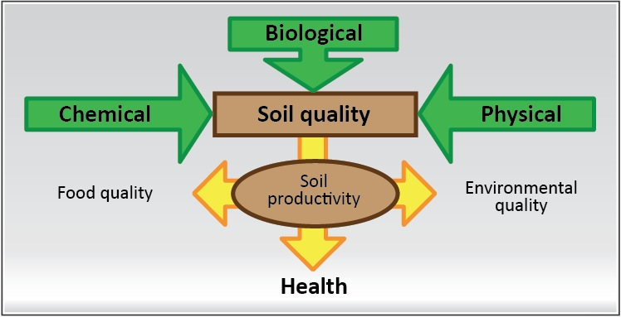
Literature Review
Use-case diagram,
Confusion over defining soil quality is often the result of not identifying major issues of concern with respond to soil function (Doran and Parkin, 1994)
This ‘Do It Yourself ‘ kit will adopt the appropriate management practices in order to boost the fertility status.

Slide 7

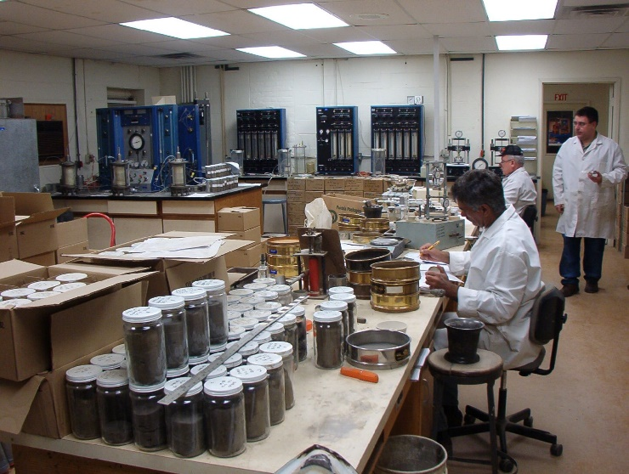
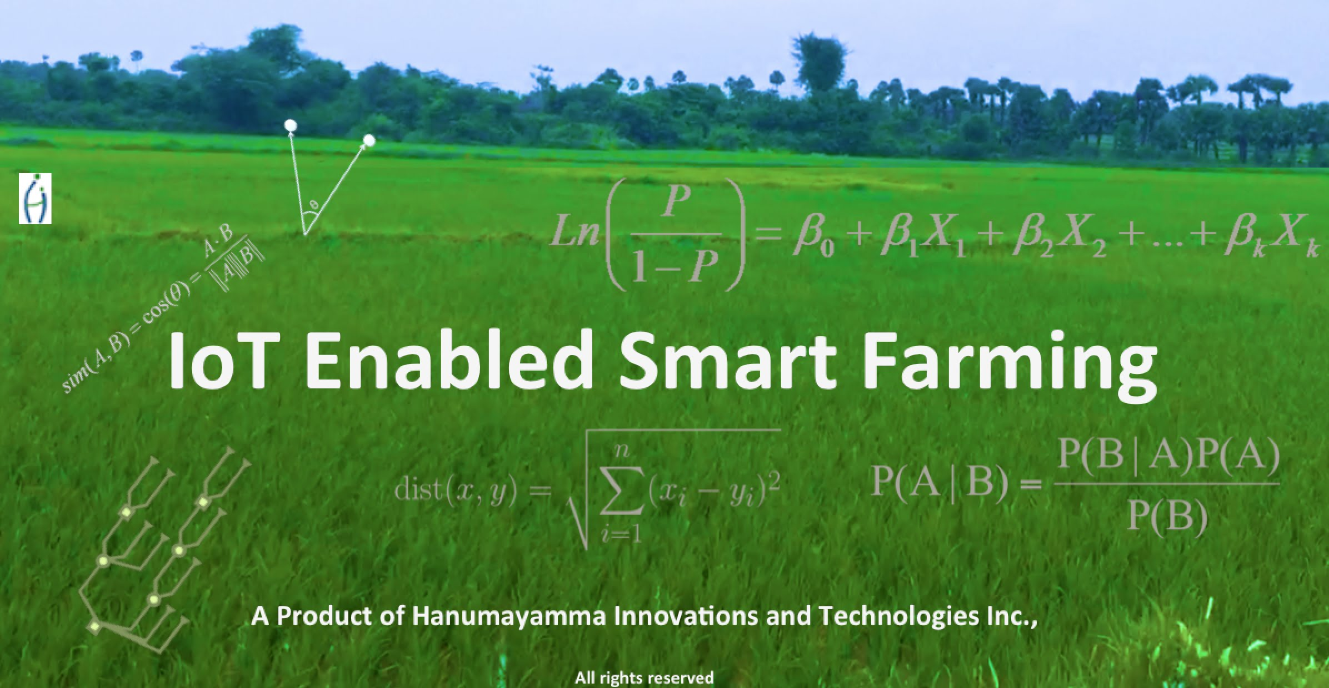
Objective
The objective of proposed system is to replace the traditional farming technique of testing soil fertility by the automated soil fertility monitoring system.
An application which provides 24*7 service to the farmers.
That will help the farmer’s in deciding, what crop to bow in the soil, based on the nutrient/pH contents present in soil at current state.

Slide 8
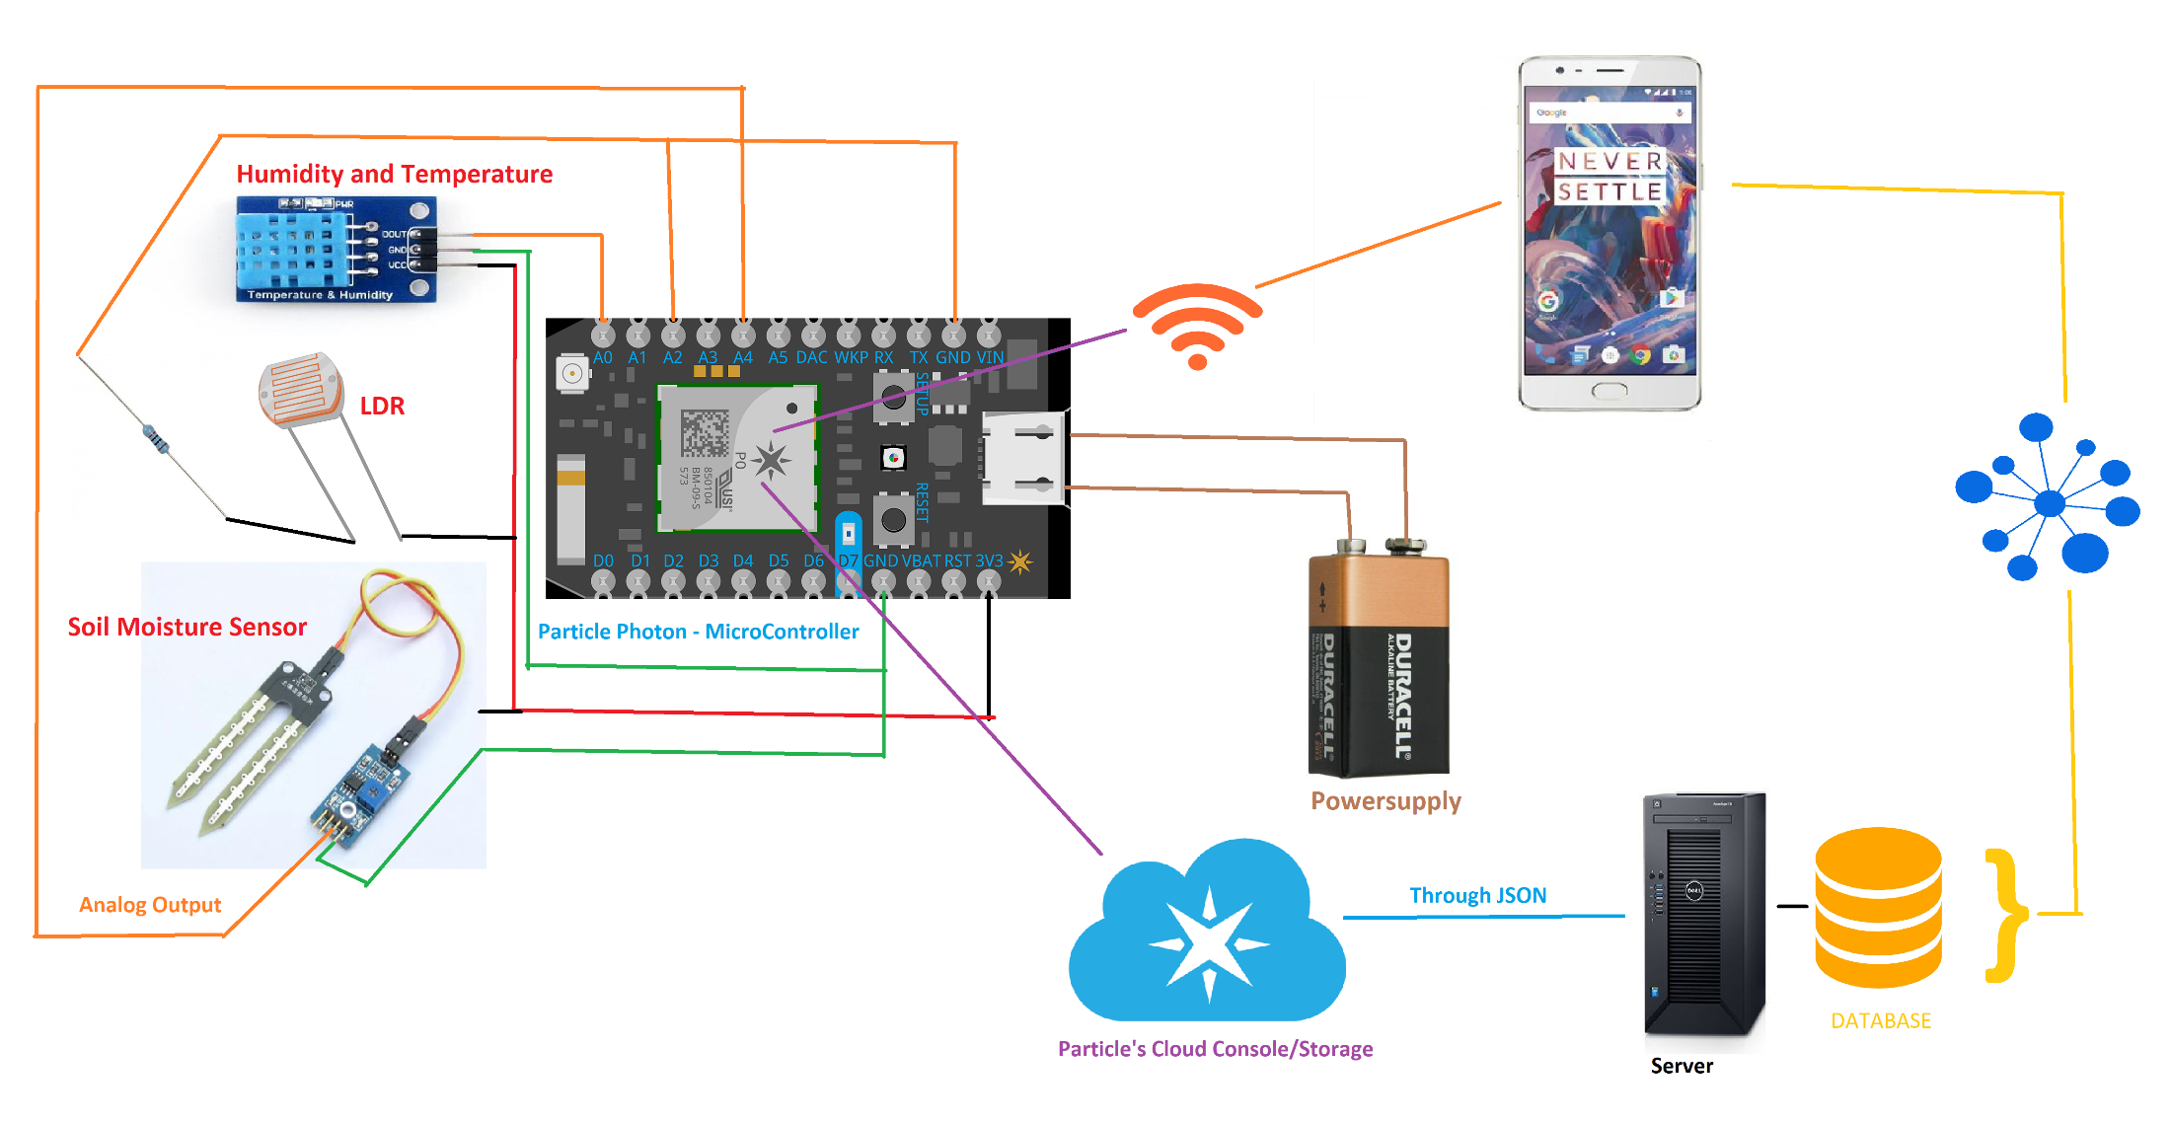
Architectural Diagram

Slide 9
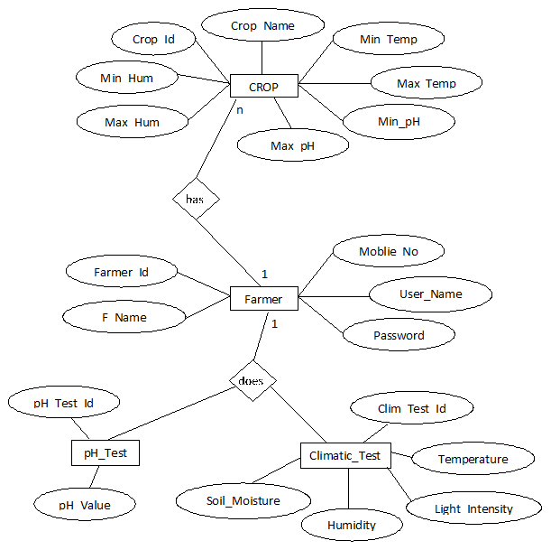
ER Diagram

Slide 10
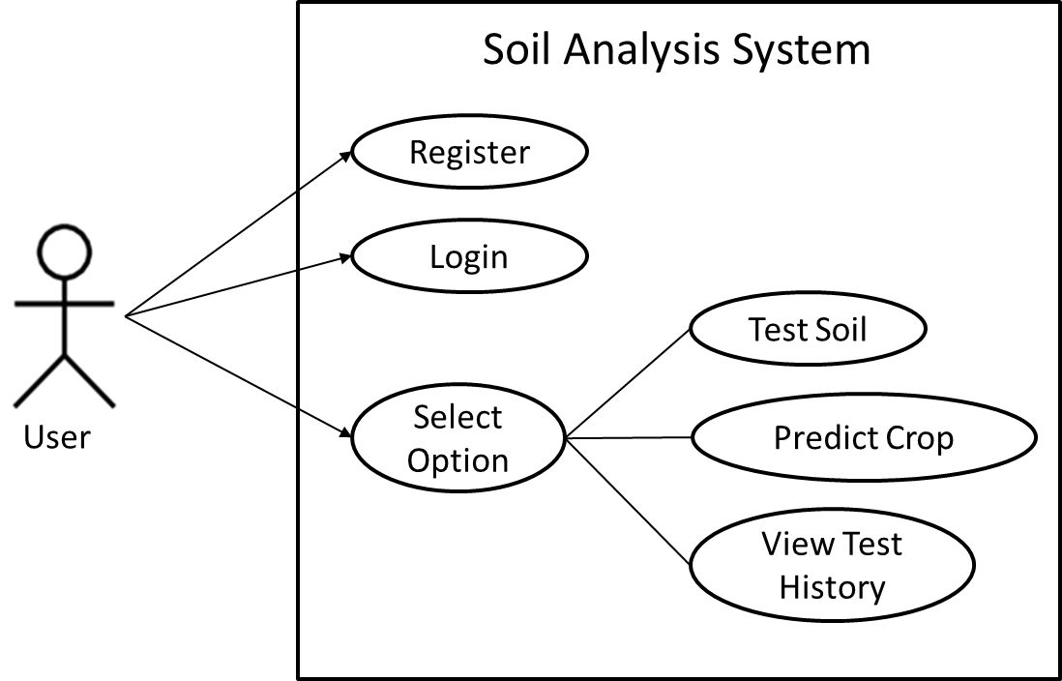
Use Case Diagram

Slide 11

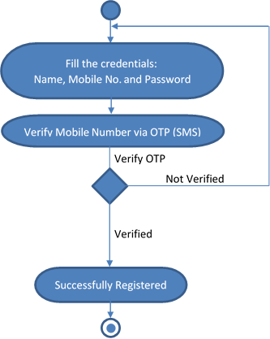
Activity Diagram
Fig. : Registration Activity Diagram

Slide 12
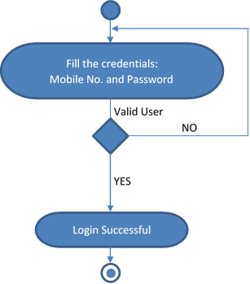
Activity Diagram
Fig. : Login Activity Diagram

Slide 13
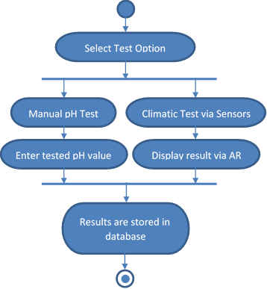
Activity Diagram
Fig. : Test Soil Activity Diagram

Slide 14
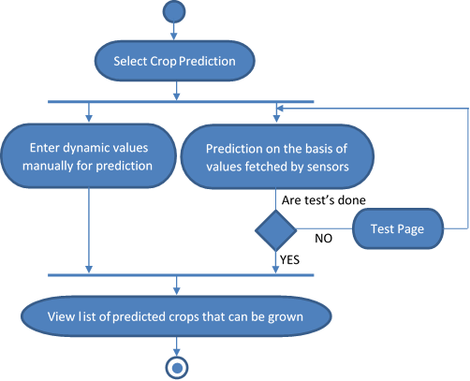
Activity Diagram
Fig. : Predict Crop Activity Diagram

Slide 15
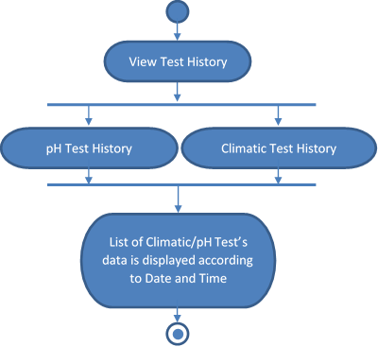
Activity Diagram
Fig. : Test History Activity Diagram

Slide 16
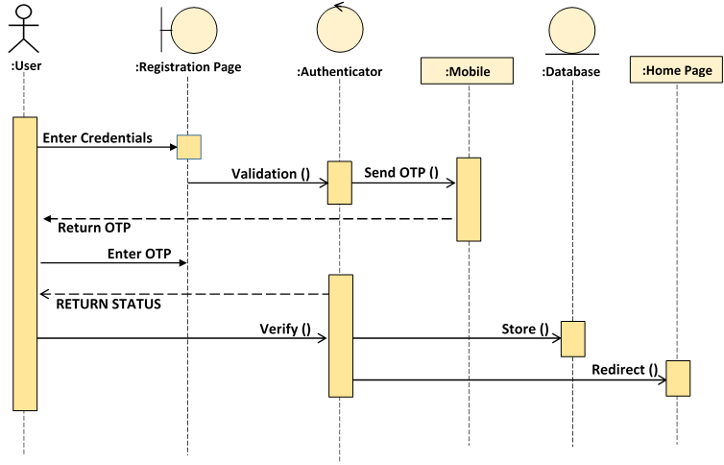
Sequence Diagram
Fig. : Registration Sequence Diagram

Slide 17
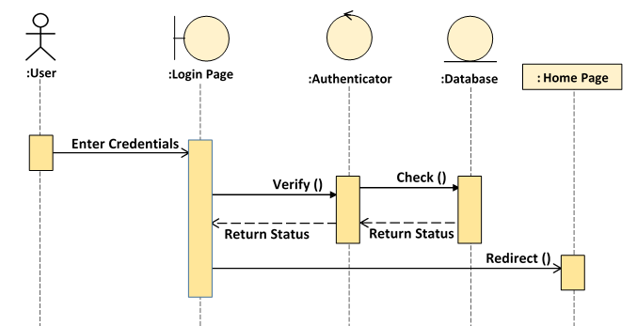
Sequence Diagram
Fig. : Login Sequence Diagram

Slide 18
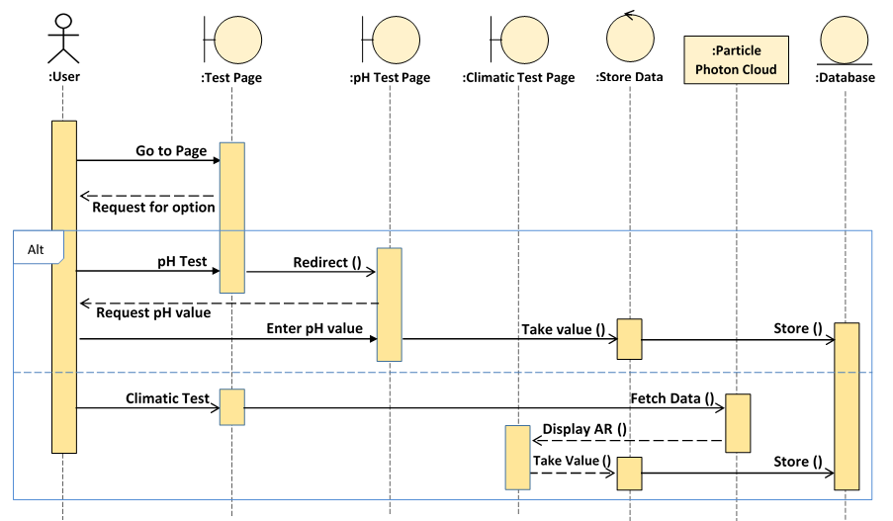
Sequence Diagram
Fig. : Test Soil Sequence Diagram

Slide 19
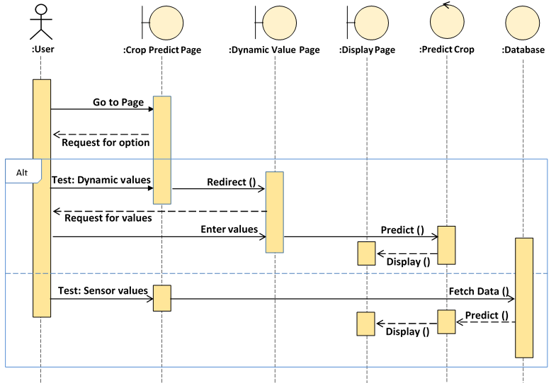
Sequence Diagram
Fig. : Prediction Crop Sequence Diagram

Slide 20
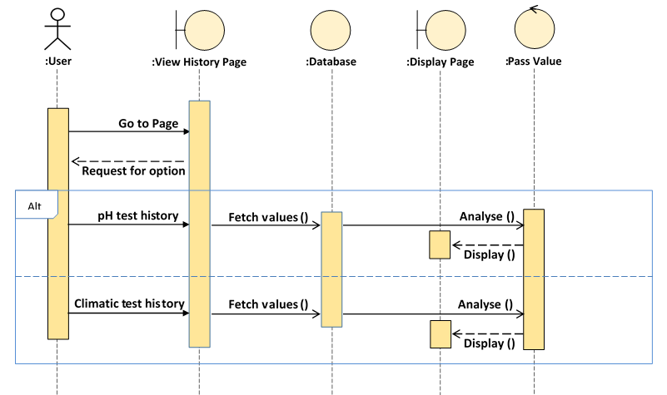
Sequence Diagram
Fig. : View Test History Sequence Diagram

Slide 21
Software & Hardware Requirement’s
(to build this project)
Software Requirement
Hardware Requirement
Unity (Engine)
Mono Develop
Vuforia
WAMP Server
MySQL Workbench
Sublime Text
Android SDK
JDK 1.7-1.8
Smart Phone (Android Version 4.4+)
PC Processor : CORE i3+
PC RAM : 4GB+
Particle Photon (Micro-Controller) [5]
Sensors:
Soil Moisture Sensor
Temperature Humidity Sensor
Light Intensity Sensor
pH paper[3]
Distilled water
Bread Board, connecting wires and batteries

Slide 22
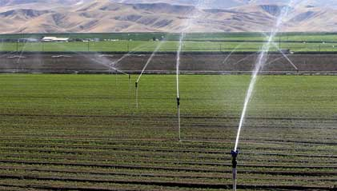
Future Work
The future scope of our project:
By integrating Relay (switch) and Water Motor in our kit, we can also automate the irrigation system in the fields.
i.e. on the basis of the data of moisture content of the soil fetched by the soil moisture sensor, the water motor will automatically start and stop according to the value’s of the moisture content pre-defined by the farmer.

Slide 23
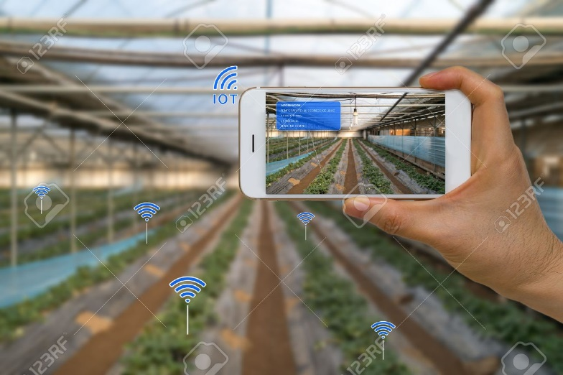
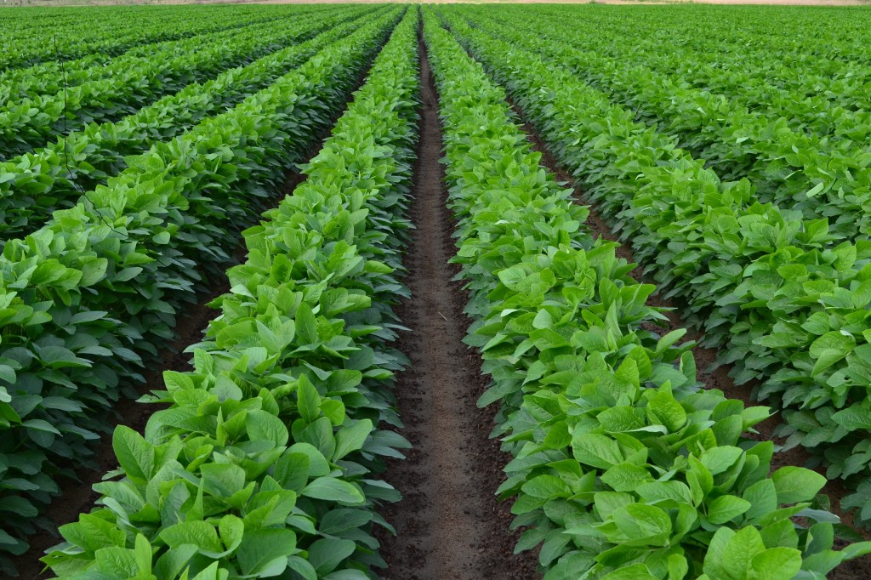
Conclusion
With the help of this application:
The data of current soil’s temperature, humidity, moisture, light intensity, pH will be fetched by the sensors and through IoT will be displayed to the user on his device by the application of Augmented Reality and via text message.
Crop Prediction will be made possible by analysing the content of the soil.
Irrigation system becomes automated.
Real-Time analysis of the soil’s fertility will be achieved which will benefit the farmer’s, resulting in better yields of the crops when worked accordingly.
Continuous evaluation will be possible without lab tests.

Slide 24
References
https://en.wikipedia.org/wiki/Soil_fertility
http://www.cropnutrition.com/
https://www.hunker.com/12148559/how-to-test-soil-ph-with-ph-paper
https://www.pioneer.com/home/site/us/agronomy/library/managing-soil-pH
https://www.particle.io/products/hardware/photon-wifi/

Slide 25


